Slide 1
OSTEOLOGY OF THE RIBS AND THORAX VERTEBRAE
BY
Dr. F.O. IGELIGE

Slide 2
INTRODUCTION
The thoracic cage, also known as the rib cage, is the osteocartilaginous structure that encloses the thorax.
It is formed by the 12 thoracic vertebrae 12 pairs of ribs and associated costal cartilages and the sternum.
The thoracic cage takes the form of a domed bird cage with the horizontal bars formed by ribs and costal cartilages.
It is supported by the vertical sternum (anteriorly) and the 12 thoracic vertebrae (posteriorly).

Slide 3
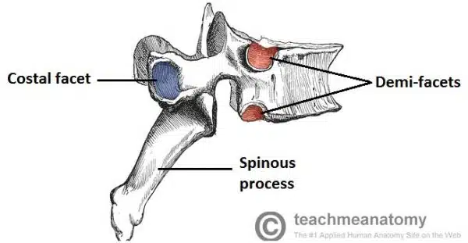
Characteristic Features
The thoracic vertebrae have four features which distinguish them from other vertebrae:
Vertebral body is heart shaped.
Presence of demi-facets on the sides of each vertebral body – these articulate with the heads of the ribs.
Presence of costal facets on the transverse processes – these articulate with the tubercles of the ribs.
They are present on T1-T10 only.
The spinous processes are long and slant inferiorly. This offers increased protection to the spinal cord, preventing an object such as a knife entering the spinal canal.

Slide 4
FUNCTION OF THE THORACIC CAGE
The main function of the thoracic cage is to support thorax and protect the vital structures within it (e.g. heart, lungs, aorta, etc).
In addition, the rigid structure of the cage allows it to be an attachment point for many muscles of the upper body and to support the weight of the upper limbs.
The thoracic cage also facilitates the act of breathing by resisting the negative pressure generated by the elastic recoil of the lungs and respiration-induced movements.

Slide 5
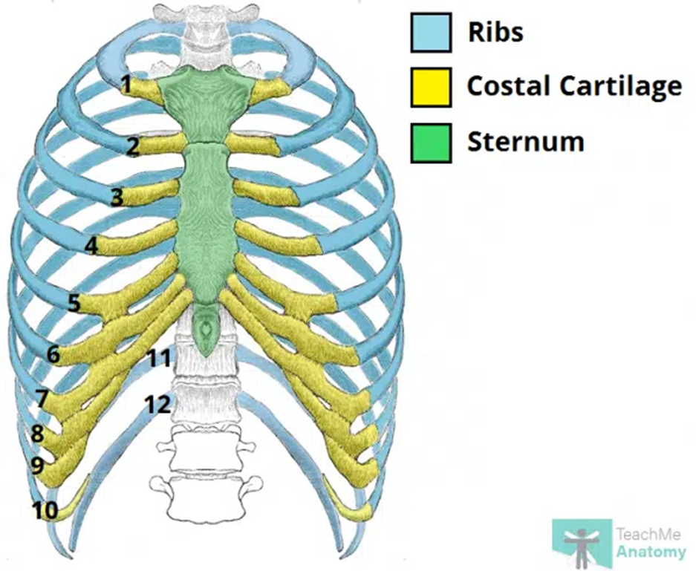
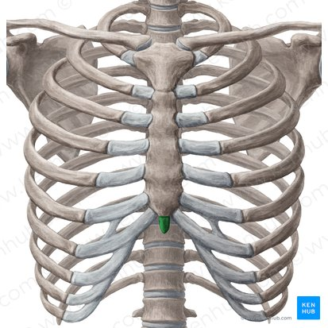
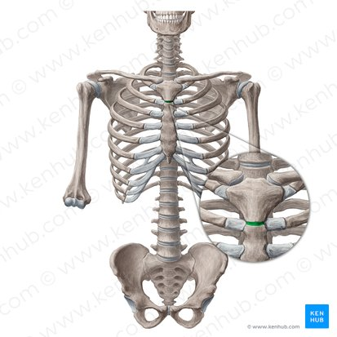

Slide 6
STERNUM
The sternum (derived from the Greek word sternon meaning chest) is a vertical bone located in the midline. It forms the anterior portion of the chest wall.
The sternum consists of three distinct bony parts:
The manubrium
The body of sternum
The xiphoid process
The manubrium is the superiormost part of the sternum. It is also thicker and wider than other parts of the sternum.
The manubrium forms articulations with the clavicle (sternoclavicular joint), body of the sternum (manubriosternal joint), first rib and superior half of the second rib (sternocostal joints).

Slide 7
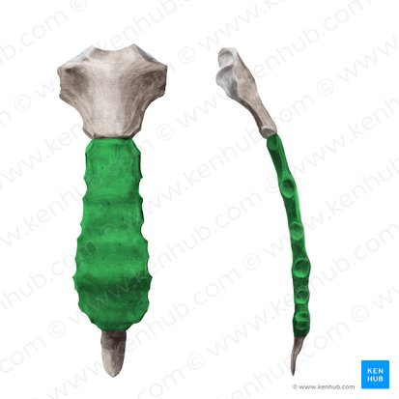
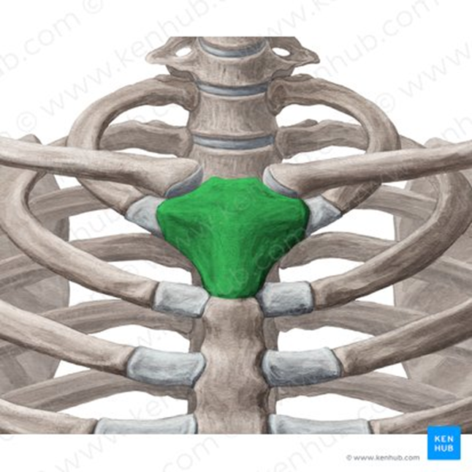
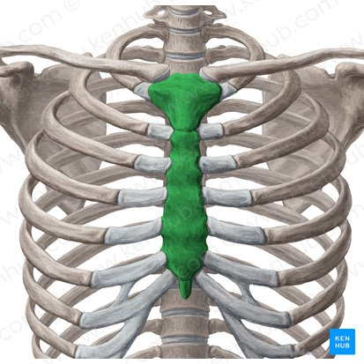
The xiphoid process is the smallest and most inferior portion of the sternum, positioned t the level of the T10 vertebra. The xiphoid process is part of the inferior margin of the thoracic cavity and marks the infrasternal angle (subcostal angle) of the inferior thoracic aperture.

Slide 8
BODY OF THE STERNUM
The body of the sternum extends from the manubrium to the xiphoid process (at the level of vertebrae T5–T9).
Superiorly, the body articulates with the manubrium and forms the manubriosternal joint and an anterior projection called the sternal angle (of Louis).
The sternal body bilaterally articulates with six ribs (2nd to 7th rib) on its lateral borders.
In addition, inferiorly the body articulates with the xiphoid process and forms the xiphisternal joint.

Slide 9
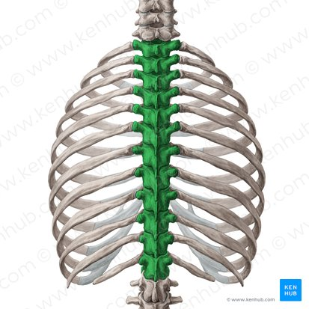
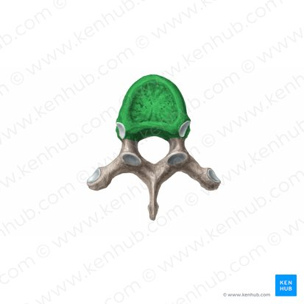
THORACIC VERTEBRAE
The thoracic vertebrae are a group of 12 irregular bones that form the thoracic portion of the vertebral spine.
According to their structure, the thoracic vertebrae can be typical and atypical.
The typical vertebrae have vertebral bodies, arches, and processes for muscular and articular connections.
They also have characteristic long spinous processes and two types of articular facets for articulation with the ribs: bilateral costal facets (demifacets) on their bodies and costal facets on the transverse processes for articulation with the tubercles of ribs.
In contrast, atypical thoracic vertebrae (T1, T10, T11, T12).
These vertebrae have “whole costal facets” in place of demifacets

Slide 10
Atypical Vertebrae
The atypical thoracic vertebrae display variation in the size, location and number of their superior and inferior costal facets.
T1 – Superior facet is not a demifacet, as this is the only vertebrae to articulate with the 1st rib.
T10 – A single pair of whole facets is present which articulate with the 10th rib. These facets are located across both the vertebral body and the pedicle.
T11 and T12 – Each have a single pair of entire costal facets, which are located on the pedicles.

Slide 11
Superior and Inferior Costal Facets
The superior and inferior costal facets are located on the sides of each vertebral body.
They consist of cartilage lined depressions, which articulate with the heads of the ribs.
The superior facet articulates with the head of the adjacent rib, and the inferior facet articulates with the head of the rib below
In the majority of the vertebrae (T2-T9) these facets are demi-facets. There are some atypical vertebrae that possess whole facets.

Slide 12
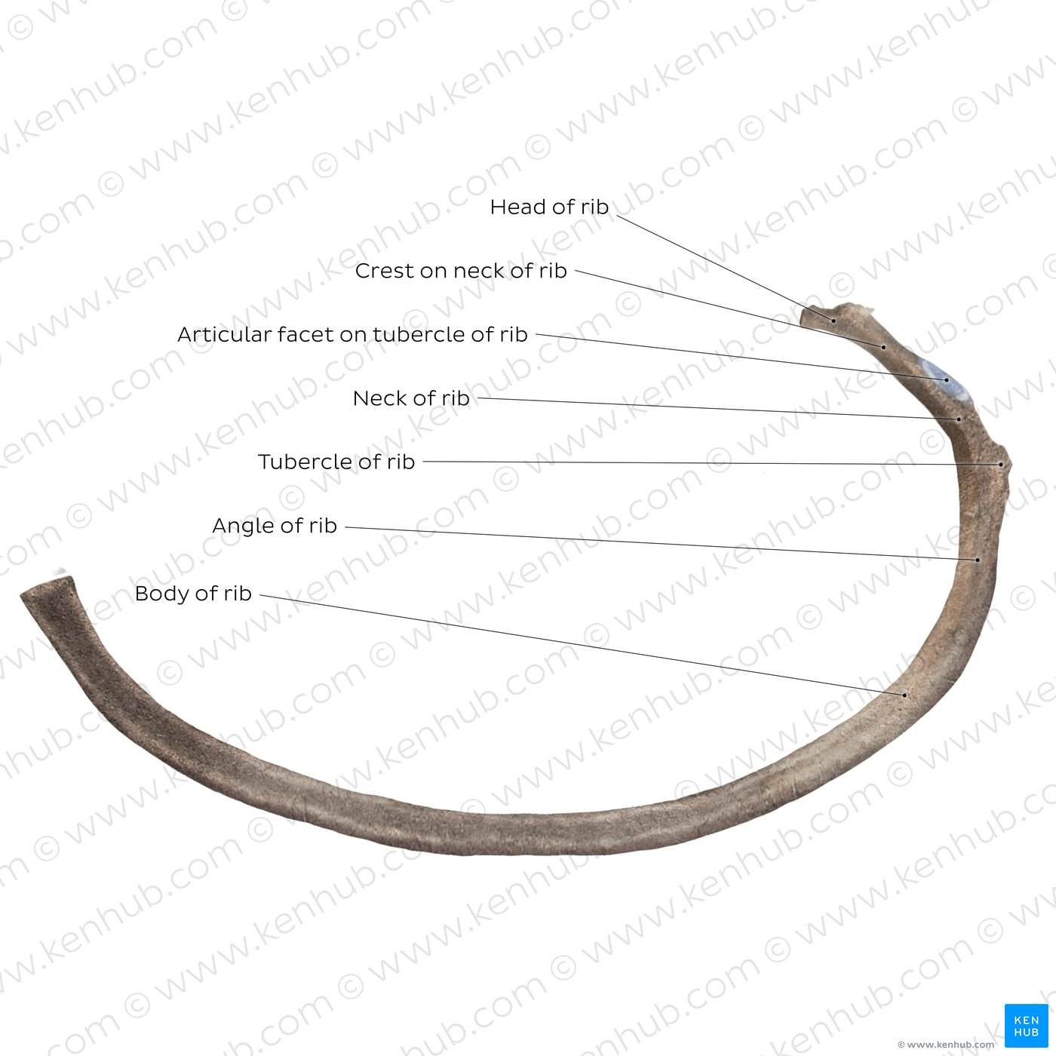
THE RIBS
The ribs are long, flat bones that enclose most of the thoracic cage. Anteriorly, the ribs are elongated with their costal cartilages which then connect with the sternum.
The first seven (and sometimes the 8th) cartilages attach directly and independently to the sternum.
The 8th, 9th and 10th cartilages articulate with the costal cartilages just superior to them, forming a continuous, articulated, cartilaginous costal margin of the rib cage.
The costal cartilages contribute to the elasticity of the thoracic wall, providing a flexible attachment for their anterior or distal ends.
According to their structure, the ribs can be divided into two groups: typical and atypical.

Slide 13
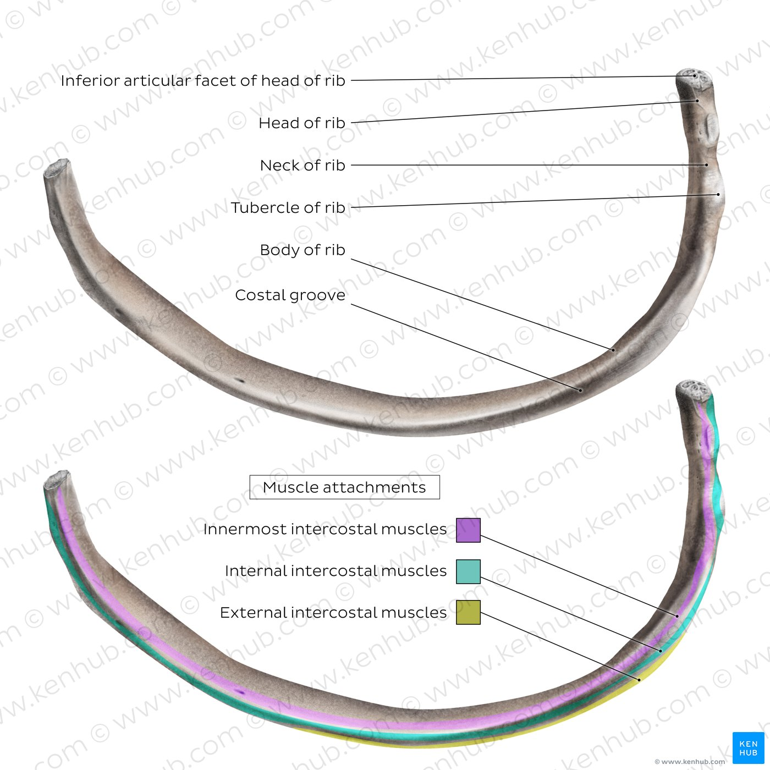
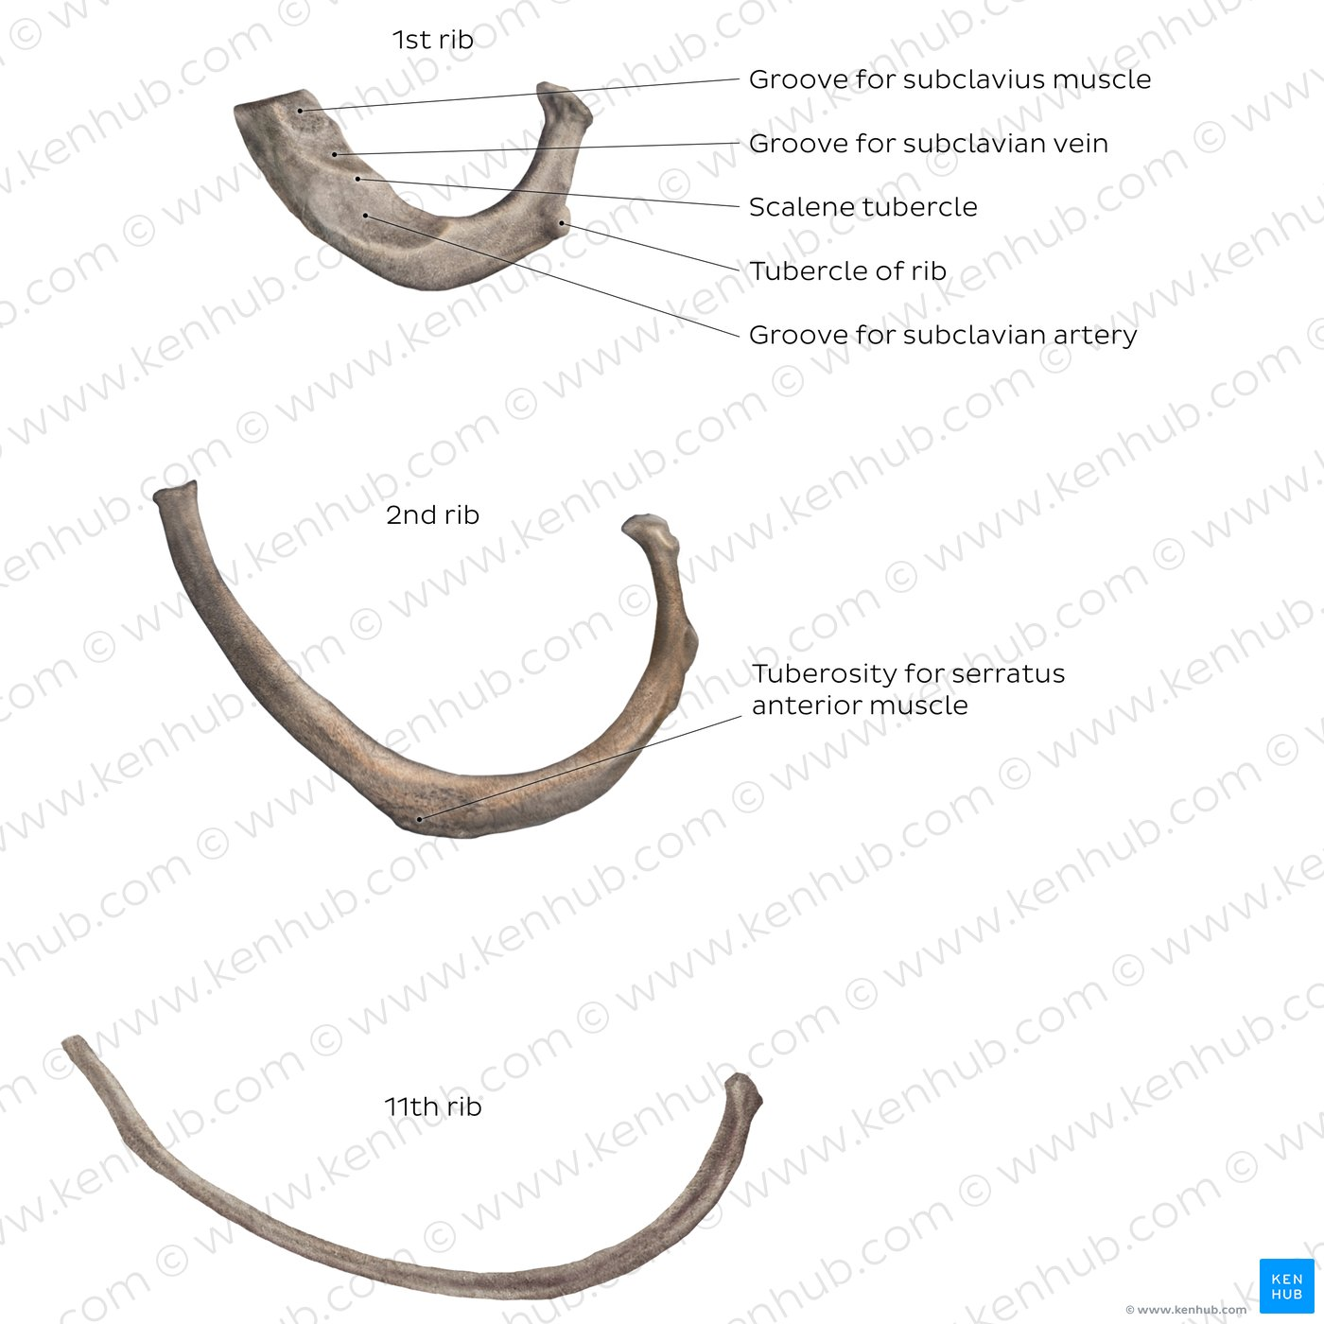
The atypical ribs (1st, 2nd, 10th-12th) also have a head, neck and body, however they differ by their morphology and/or unique landmarks (e.g. attachment points for subclavius/scalene muscles and and grooves for subclavian vessels (1st rib), tuberosity for serratus anterior muscle (2nd rib). The 11th and 12th ribs are more slender than the other ribs and lack several of the typical landmarks seen on typical ribs

Slide 14
Typically, the ribs have the following anatomical components:
Head with two articular facets
Tubercle
Neck
Shaft
Costal groove
Most of the ribs are typical ribs; which means that they have all these features. The atypical ribs which do not have all these features are:
First rib
Second rib
Tenth rib
Eleventh rib
Twelfth rib
The first rib is atypical because it is wide and short, has two costal grooves, and one articular facet.

Slide 15
The second rib is thin, long, and has a tuberosity on its superior surface for the attachment of the serratus anterior muscle.
The tenth rib has only one articular facet.
The eleventh and twelfth ribs have only one articular facet with no neck.

Slide 16
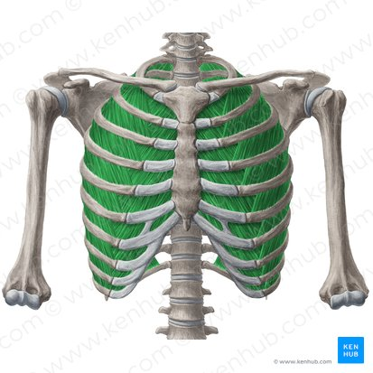
The intercostal spaces
are simply the spaces between the ribs.
They separate the ribs and their costal cartilages from one another and allow smooth expansion of the cage during inspiration.
There are 11 intercostal spaces, and each space is named according to the rib which is the superior border of the space.
For example, the 6th intercostal space is located between the 6th and 7th rib.
Intercostal spaces are mainly occupied by intercostal muscles and membranes. The spaces also contain 11 intercostal nerves and intercostal blood vessels named by the same number assigned to the intercostal space. The space inferior to the 12th rib is referred to as the subcostal space.

Slide 17
The spaces also contain 11 intercostal nerves and intercostal blood vessels named by the same number assigned to the intercostal space. The space inferior to the 12th rib is referred to as the subcostal space. The subcostal space hosts the anterior ramus of the spinal nerve T12 runs through this space, and it is thus referred to as the subcostal nerve.
Joints
The joints forming the domed-shaped thoracic cage include the:
Xiphisternal joint – xiphoid process and body of sternum
Intervertebral joints – between vertebrae
Sternochondral joints – sternum and costal cartilages
Sternoclavicular joints – manubrium and clavicles
Manubriosternal joints – manubrium and body of sternum
Costochondral joints – costal cartilage and rib
Costovertebral joints – formed by the ribs and bodies of the vertebrae.
Interchondral joints – joining the costal cartilages to one another.

Slide 18
Joints
The joints of the thoracic spine can be divided into two groups – those that are present throughout the vertebral column, and those unique to the thoracic spine.
Present throughout Vertebral Column
There are two types of joints present throughout the vertebral column:
Between vertebral bodies – adjacent vertebral bodies are joined by intervertebral discs, made of fibrocartilage. This is a type of cartilaginous joint, known as a symphysis.
Between vertebral arches – formed by the articulation of superior and inferior articular processes from adjacent vertebrae. It is a synovial type joint.

Slide 19
Unique to Thoracic Spine
The articulations between the vertebrae and the ribs are unique to the thoracic spine. For each rib, there are two separate articulations – costovertebral and costotransverse.
Each costovertebral joint consists of the head of the rib articulating with:
Superior costal facet of the corresponding vertebra
Inferior costal facet of the superior vertebra
Intervertebral disc separating the two vertebrae
Within this joint, the intra-articular ligament of head of rib attaches the rib head to the intervertebral disc. Only slight gliding movements can occur at these joints, due to the close articulation of their components.

Slide 20
The costotransverse joints are formed by the articulation of transverse processes of a thoracic vertebra and the tubercle of the adjacent rib.
They are present in all vertebrae except T11 and T12.
The costochondral joints are the articulations between each rib and its costal cartilage.
It is a hyaline cartilaginous type of joint.
The articulation is between the cup-shaped depression in the sternal end of a rib and the lateral end of a costal cartilage.
The rib and its cartilage are firmly bound together by the continuity of the periosteum of the rib with the perichondrium of the cartilage.
No movement normally occurs at these joints.

Slide 21
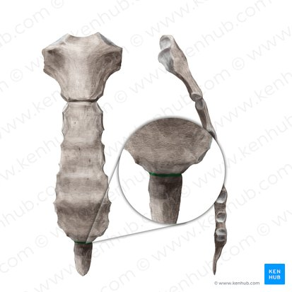
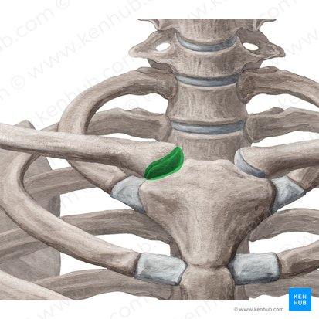
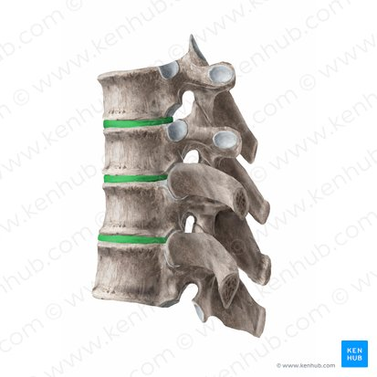
Interchondral joints
The interchondral joints are plane synovial joints between the adjacent borders of the 6th and 7th, 7th and 8th, and 8th and 9th costal cartilages.
The joints are usually strengthened by interchondral ligaments, and they also have synovial cavities that are enclosed by joint capsules.

Slide 22
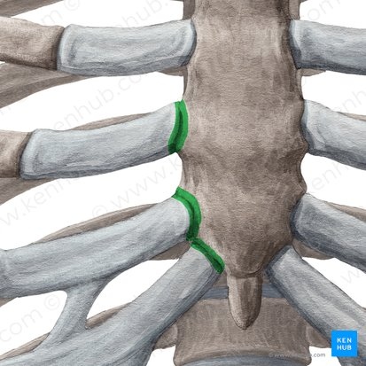
The sternocostal (sternochondral) joints are formed by the lateral borders of the sternum and the costal cartilages of the 1st to 7th ribs, and sometimes the 8th rib.
The first pair of costal cartilages articulate with the manubrium by means of a thin dense layer of tightly adherent fibrocartilage interposed between cartilage and the manubrium, the synchondrosis of the first rib.
The second to seventh pairs of costal cartilages articulate with the sternum at synovial joints with fibrocartilaginous articular surfaces on both the chondral and sternal aspects, allowing movement during respiration.

Slide 23
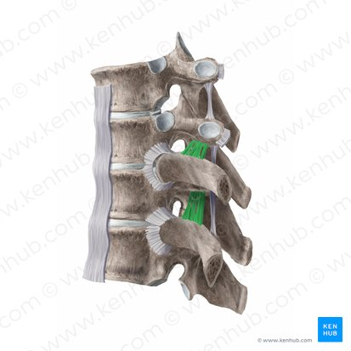
Articulation of the left and right ribs with the vertebral column (thoracic vertebrae) complete the thoracic cage posteriorly. The costovertebral joints are synovial joints, and they are surrounded by joint capsule.
Most of the ribs are attached firmly to the intervertebral (IV) discs by intra-articular ligament within the joints. Fanning around from the anterior margin of the heads of the ribs to the sides of the bodies of vertebrae and the IV discs between them is a radiate sternocostal ligament. Also crossing these joints is the costotransverse ligament passing from the neck of the rib to the transverse process, and a lateral costotransverse ligament passing from the tubercle of the rib to the tip of the transverse process. These ligaments strengthen the anterior and posterior aspects of the joints respectively. There is a superior costotransverse ligament which may be divided into a strong anterior costotransverse ligament and a weak posterior costotransverse ligament, both joining the crests of the neck of the ribs to the transverse processes superior to each of the ribs.

Slide 24
CLINICAL ANATOMY
Dislocation of costochondral joint
Dislocation at this joint leads to separation of a rib from its costal cartilage. This usually occurs as a result of tearing of the perichondrium and periosteum leading to an upward movement of the affected rib, overriding the rib above and causing severe pains.
Dislocation of sternocostal and interchondral joints
Sternocostal and/or interchondral joint dislocation is the displacement of a costal cartilage from the sternum. This leads to dislocation of the corresponding rib, a condition referred to as slipping rib syndrome.
Displacement of interchondral joints usually occurs unilaterally and involves ribs 8,9, and 10. Trauma sufficient to displace these joints often injures underlying structures such as the diaphragm and/or liver, causing severe pain, particularly during deep inspiratory movements.
Rib dislocations are common in body contact sports, and complications may result from pressure on or damage to nearby nerves, blood vessels, and muscles.

Slide 25
Flail chest
Multiple rib fractures may allow a segment of the anterior and/or lateral thoracic wall to move freely but paradoxically inward on inspiration and outward on expiration. Flail chest is an extremely painful injury and impairs ventilation thereby affecting oxygenation of the blood.
Supernumerary ribs
As the name suggests, this is a clinically significant condition in which there is distortion of the normal number of ribs forming the thoracic cage.
Supernumerary or extra ribs have clinical significance in that they may confuse the identification of vertebral levels in radiographs and other diagnostic images.
Usually, there are 12 ribs on each side of the vertebral column, but the number is increased by the presence of cervical and/or lumbar ribs, or decreased by failure of the 12th pair to form.

